Slide 1
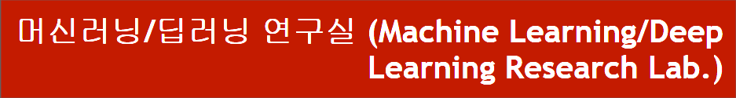
DARTS research progress
Department of Computer Engineering
Dongseo University
Jie Yong Shin,
Dae-Ki Kang, Prof (advisor)
2022.05.27
Notes:
1

Slide 2
CONTENTS
1. Continuous Relaxation
2. Discussion
3. Related Work
4. Idea
Notes:
2

Slide 3
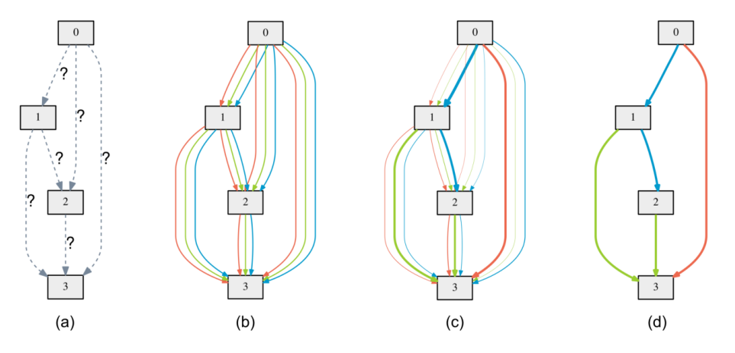
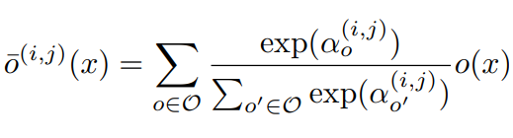
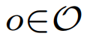
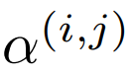
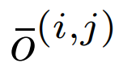
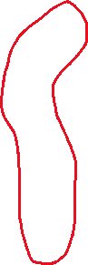
1. Continuous Relaxation
: Example of a set O : {Convolution, Pooling, Skip, Dilation}
: Weights of operations (Vector)
: Mixed operation
Notes:
3

Slide 4
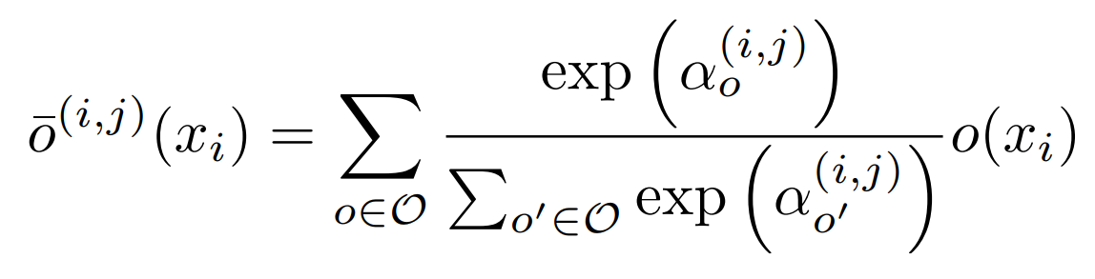
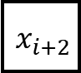
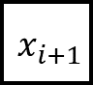
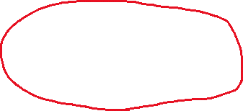
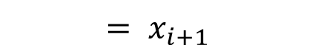
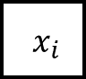
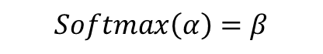
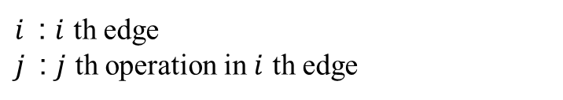
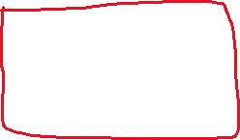
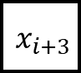
1. Continuous Relaxation
Operation pool = [Convolution,
Pooling,
Skip,
Dilation]
$${ x}_{i}$$
$${ x}_{i+1}$$
$${ x}_{i+2}$$
$${ x}_{i+3}$$
$$Softmax\left(α\right)=β$$
$${= x}_{i+1}$$
$i$ : $i$ th edge
$j$ : $j$ th operation in $i$ th edge
Notes:
4

Slide 5
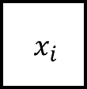


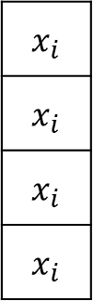
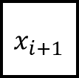
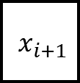
1. Continuous Relaxation
$${ x}_{i}$$
$${ x}_{i+1}$$
$${ x}_{i}$$
Convolution()
Pooling()
Skip()
Dilation()
$$x_{i}$$
$$x_{i}$$
$$x_{i}$$
$$x_{i}$$
+
$${ x}_{i+1}$$
Convolution($x_{i}$) + Pooling($x_{i}$) + Skip($x_{i}$) + Dilation($x_{i}$) = out
Notes:
5

Slide 6
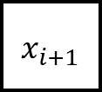

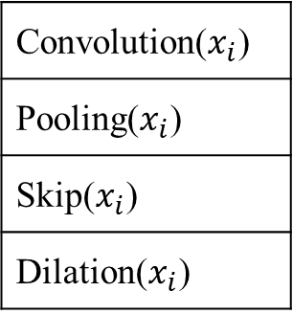
1. Continuous Relaxation
$${ x}_{i}$$
$${ x}_{i+1}$$
Convolution($x_{i}$)
Pooling($x_{i}$)
Skip($x_{i}$)
Dilation($x_{i}$)
+
$${ x}_{i+1}$$
Convolution($x_{i}$) + Pooling($x_{i}$) + Skip($x_{i}$) + Dilation($x_{i}$) = out
Notes:
6

Slide 7
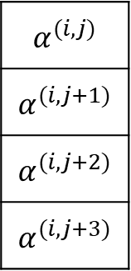
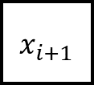
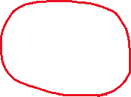
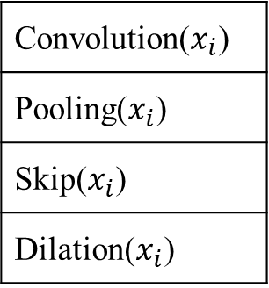
1. Continuous Relaxation
$${ x}_{i}$$
$${ x}_{i+1}$$
$$α^{(i,j)}$$
$$α^{(i,j+1)}$$
$$α^{(i,j+2)}$$
$$α^{(i,j+3)}$$
x
Convolution($x_{i}$)
Pooling($x_{i}$)
Skip($x_{i}$)
Dilation($x_{i}$)
x
+
$${ x}_{i+1}$$
x
x
$α$ · Convolution($x_{i}$) + $α$ · Pooling($x_{i}$) + $α$ · Skip($x_{i}$) + $α$ · Dilation($x_{i}$) = out
Notes:
7

Slide 8
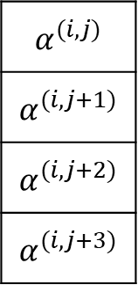
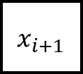
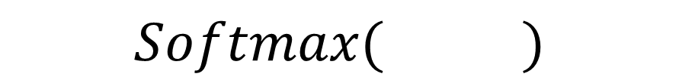
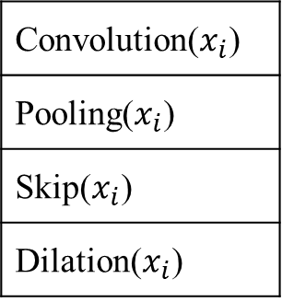
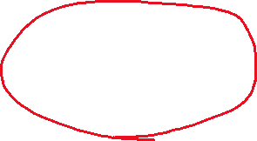
1. Continuous Relaxation
$${ x}_{i}$$
$${ x}_{i+1}$$
$$α^{(i,j)}$$
$$α^{(i,j+1)}$$
$$α^{(i,j+2)}$$
$$α^{(i,j+3)}$$
x
Convolution($x_{i}$)
Pooling($x_{i}$)
Skip($x_{i}$)
Dilation($x_{i}$)
x
$$Softmax( )$$
+
$${ x}_{i+1}$$
x
x
$α$ · Convolution($x_{i}$) + $α$ · Pooling($x_{i}$) + $α$ · Skip($x_{i}$) + $α$ · Dilation($x_{i}$) = out
Notes:
8

Slide 9
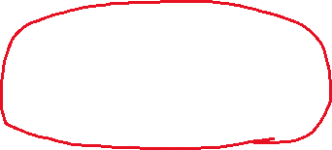
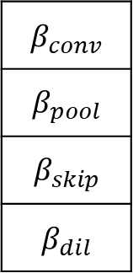

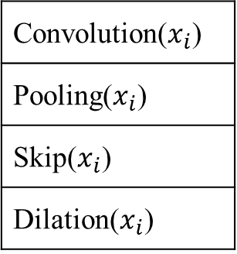
1. Continuous Relaxation
$${ x}_{i}$$
$${ x}_{i+1}$$
$$β_{conv}$$
$$β_{pool}$$
$$β_{skip}$$
$$β_{dil}$$
x
Convolution($x_{i}$)
Pooling($x_{i}$)
Skip($x_{i}$)
Dilation($x_{i}$)
x
+
$${ x}_{i+1}$$
x
x
$β$ · Convolution($x_{i}$) + $β$· Pooling($x_{i}$) + $β$· Skip($x_{i}$) + $β$· Dilation($x_{i}$) = out
Notes:
9

Slide 10
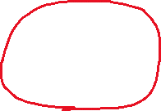
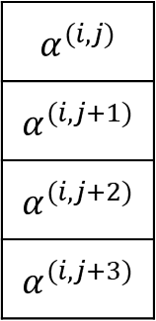
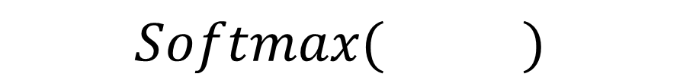
1. Continuous Relaxation
$${ x}_{i}$$
$${ x}_{i+1}$$
$$α^{(i,j)}$$
$$α^{(i,j+1)}$$
$$α^{(i,j+2)}$$
$$α^{(i,j+3)}$$
$$Softmax( )$$
Notes:
10

Slide 11
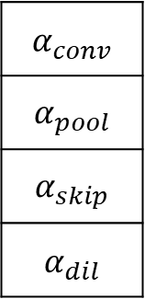
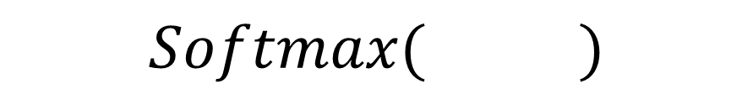
1. Continuous Relaxation
$${ x}_{i}$$
$${ x}_{i+1}$$
$$α_{conv}$$
$$α_{pool}$$
$$α_{skip}$$
$$α_{dil}$$
$$Softmax( )$$
Notes:
11

Slide 12
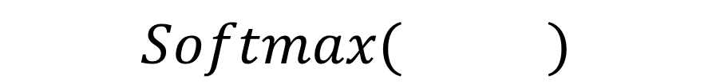
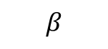
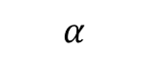
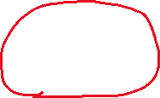
1. Continuous Relaxation
$${ x}_{i}$$
$${ x}_{i+1}$$
$$α$$
$$β$$
2
1
0.1
1.5
0.47
0.17
0.07
0.28
$$Softmax( )$$
Notes:
12

Slide 13
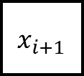
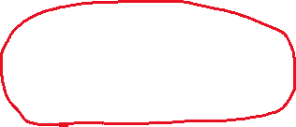
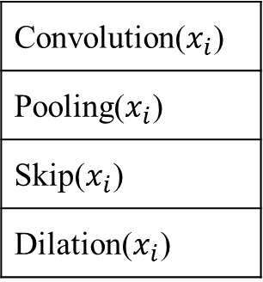
1. Continuous Relaxation
$${ x}_{i}$$
$${ x}_{i+1}$$
0.47
0.17
0.07
0.28
x
Convolution($x_{i}$)
Pooling($x_{i}$)
Skip($x_{i}$)
Dilation($x_{i}$)
x
+
$${ x}_{i+1}$$
x
x
Notes:
13

Slide 14
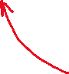
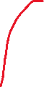
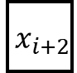









1. Continuous Relaxation
Back-propagation
$${ x}_{i}$$
$${ x}_{i+1}$$
$${ x}_{i+2}$$
$${ x}_{i+3}$$
$$L_{val}(L_{train}\left(w^{∗}\right), α)$$
Notes:
14

Slide 15




1. Continuous Relaxation
$${ x}_{i}$$
$${ x}_{i+1}$$
0.48
0.17
0.07
0.28
x
Convolution($x_{i}$)
Pooling($x_{i}$)
Skip($x_{i}$)
Dilation($x_{i}$)
x
+
$${ x}_{i+1}$$
$$L_{val}(L_{train}\left(w^{∗}\right), α)$$
x
x
Notes:
15

Slide 16


1. Continuous Relaxation
$${ x}_{i}$$
$${ x}_{i+1}$$
Search end
0.1
0.2
0.4
0.3
x
Convolution($x_{i}$)
Pooling($x_{i}$)
Skip($x_{i}$)
Dilation($x_{i}$)
x
+
$${ x}_{i+1}$$
x
x
Notes:
16

Slide 17

1. Continuous Relaxation
$${ x}_{i}$$
$${ x}_{i+1}$$
One-hot encoding
0
0
1
0
x
Convolution($x_{i}$)
Pooling($x_{i}$)
Skip($x_{i}$)
Dilation($x_{i}$)
x
+
$${ x}_{i+1}$$
x
x
Notes:
17

Slide 18


1. Continuous Relaxation
$${ x}_{i}$$
$${ x}_{i+1}$$
Skip($x_{i}$)
$${ x}_{i+1}$$
Notes:
18

Slide 19

2. Discussion
Problem
Discrepancies between continuous architecture encoding and derived discrete architecture.
skip connection become dominant.
Notes:
19

Slide 20





3. Related Work
DARTS’s Mixed operation
Gumbel-Softmax DARTS
Fair DARTS
Notes:
20

Slide 21





3. Related Work
Mixed operation with Temperature Anealing
0.48
0.17
0.07
0.28
x
Convolution($x_{i}$)
Pooling($x_{i}$)
Skip($x_{i}$)
Dilation($x_{i}$)
x
+
$${ x}_{i+1}$$
$$L_{val}(L_{train}\left(w^{∗}\right), α)$$
x
x
Notes:
21

Slide 22


4. Idea
$${ x}_{i}$$
$${ x}_{i+1}$$
0.1
0.2
0.4
0.3
x
Convolution($x_{i}$)
Pooling($x_{i}$)
Skip($x_{i}$)
Dilation($x_{i}$)
x
+
$${ x}_{i+1}$$
x
x
Idea
Temperature annealing with decay. (exploration/exploitation)
Decrease the number of competitor. (to make it non-linear)
Notes:
22

Slide 23


4. Idea (1/2)
Decaying Temperature
First, more exploration with high temperature.
0.24
0.26
0.23
0.28
x
Convolution($x_{i}$)
Pooling($x_{i}$)
Skip($x_{i}$)
Dilation($x_{i}$)
x
+
$${ x}_{i+1}$$
x
x
Notes:
23

Slide 24
4. Idea (1/2)
Decaying Temperature
After then, more exploitation with law temperature.
0.1
0.1
0.1
0.7
x
Convolution($x_{i}$)
Pooling($x_{i}$)
Skip($x_{i}$)
Dilation($x_{i}$)
x
+
$${ x}_{i+1}$$
x
x
Notes:
24

Slide 25



4. Idea (2/2)
Skip connection become dominant because of its linearity
0.1
0.1
0.4
0.2
x
Convolution($x_{i}$)
Pooling($x_{i}$)
Skip($x_{i}$)
Dilation($x_{i}$)
x
+
$${ x}_{i+1}$$
$$L_{val}(L_{train}\left(w^{∗}\right), α)$$
x
x
Notes:
25

Slide 26






4. Idea (2/2)
1 ~ 100 epoch
0.25
0.25
0.25
0.25
x
Convolution($x_{i}$)
Pooling($x_{i}$)
Skip($x_{i}$)
Dilation($x_{i}$)
x
+
$${ x}_{i+1}$$
$$L_{val}(L_{train}\left(w^{∗}\right), α)$$
x
x
After 100 epoch
0.2
0
0.4
0
x
Convolution($x_{i}$)
Pooling($x_{i}$)
Skip($x_{i}$)
Dilation($x_{i}$)
x
+
$${ x}_{i+1}$$
$$L_{val}(L_{train}\left(w^{∗}\right), α)$$
x
x
Notes:
26

Slide 27






4. Idea (2/2)
101 ~ 200 epoch
0.5
0.5
x
Skip($x_{i}$)
Convolution($x_{i}$)
+
$${ x}_{i+1}$$
$$L_{val}(L_{train}\left(w^{∗}\right), α)$$
x
Search end
0.1
0.9
x
Skip($x_{i}$)
Convolution($x_{i}$)
+
$${ x}_{i+1}$$
$$L_{val}(L_{train}\left(w^{∗}\right), α)$$
x
Notes:
27

Slide 28
References
DARTS: Differentiable Architecture Search https://arxiv.org/abs/1806.09055
Differentiable Architecture Search with Ensemble Gumbel-Softmax https://arxiv.org/abs/1905.01786
Categorical Reparameterization with Gumbel-Softmax https://arxiv.org/abs/1611.01144
Fair DARTS: Eliminating Unfair Advantages in Differentiable Architecture Search https://arxiv.org/abs/1911.12126
Notes:
28

Slide 29
Thank you
Q & A
29
Notes:
-
The training of procedure for is to maximize the probability of D making a mistake. This framework corresponds to a minimax two-player game.
In the space of arbitrary functions G and D, a unique solution exists, with G recovering the training data distribution and D equal to ½ everywhere.
29

Slide 30




1. DARTS
$${ x}_{i}$$
$${ x}_{i+1}$$
$${Softmax(α}^{i,j})$$
$${Softmax(α}^{i,j+1})$$
$${Softmax(α}^{i,j+2})$$
$${Softmax(α}^{i,j+3})$$
x
Convolution($x_{i}$)
Pooling($x_{i}$)
Skip($x_{i}$)
Dilation($x_{i}$)
x
+
$${ x}_{i+1}$$
x
x
$β$ · Convolution($x_{i}$) + $β$· Pooling($x_{i}$) + $β$· Skip($x_{i}$) + $β$· Dilation($x_{i}$) = out
Notes:
30

Slide 31





1. DARTS
$${ x}_{i}$$
$${ x}_{i+1}$$
$${ x}_{i}$$
$$α^{(i,j)}$$
$$α^{(i,j+1)}$$
$$α^{(i,j+2)}$$
$$α^{(i,j+3)}$$
x
Convolution()
Pooling()
Skip()
Dilation()
$$x_{i}$$
$$x_{i}$$
$$x_{i}$$
$$x_{i}$$
x
+
$${ x}_{i+1}$$
x
x
$α$ * convolution($x_{i}$) + $α$ * pooling($x_{i}$) + $α$ * skip($x_{i}$) + $α$ * dilation($x_{i}$) = out
Notes:
31

Slide 32



1. DARTS
$${ x}_{i}$$
$${ x}_{i+1}$$
$$x_{i}$$
$$x_{i}$$
$$x_{i}$$
$$x_{i}$$
Convolution()
Pooling()
Skip()
Dilation()
$${ x}_{i}$$
+
$${ x}_{i+1}$$
convolution($x_{i}$) + pooling($x_{i}$) + skip($x_{i}$) + dilation($x_{i}$) = out
Notes:
32

Slide 33





3. Idea
Mixed operation with Temperature Anealing
$${\overline{o}}^{\left(i,j\right)}\left(x\right)=\sum_{o∈O}{\frac{\exp\left({a_{o}^{\left(i,j\right)}}/T\right)}{\sum_{o∈O}{\exp\left({a_{o^{′}}^{\left(i,j\right)}}/T\right)}}o\left(x\right)}$$
Notes:
33

Slide 34


5. Research Progress
Notes:
34

Slide 35

3. Code Analysis
train_search.py
Notes:
35

Slide 36

3. Code Analysis
train_search.py
Notes:
36

Slide 37

3. Code Analysis
train_search.py
Notes:
37

Slide 38

3. Code Analysis
train.py
Notes:
38

Slide 39

3. Code Analysis
test.py
Notes:
39

Slide 40

3. Code Analysis
Genotype
Notes:
40

Slide 41

3. Code Analysis
Operators
Notes:
41

Slide 42


3. Code Analysis
Notes:
42

Slide 43

3. Code Analysis
Notes:
43

Slide 44


4. Problems Discussed
Common case)
After 50th epoch
After 50th epoch
Notes:
44

Slide 45

6. Conclusion and Discussion
이러한 결과는 기존의 Neural Architecture Search 문제를 제기하고 해결한
NAS, ENAS등의 유명 논문들이 채용한 문제 세팅을 DARTS에서도 그대로 채용하였기 때문에 softmax만으로는 충분한 continuous relaxation을 이끌어내지 못했기 때문이라고 생각함. 8가지 operation이 아닌, 10만개 정도의 operation이 있다면 어느정도 충분한 relaxation이 가능할 것으로 예상되나, 이는 목적에 맞지 않는 불필요하게 너무 많은 operation일 수 있다.
Notes:
45

Slide 46



1. Summary
Approximation that significantly reduces search cost
Notes:
46

Slide 47

1. Summary
As a result, it outperforms other SOTA algorithms
Notes:
47

Slide 48

2. Search space
Directed Acyclic Graph
Notes:
48

Slide 49



2. Search space
Directed Acyclic Graph
x(i) : input
x(j) : output
o(i,j) : operation (transforms x(i))
Notes:
49

Slide 50



3. Continuous relaxation and optimization
The task of architecture search then reduces to learning a set of continuous variables α = { α (i,j) }
At the end of the search, replace
with
Notes:
50

Slide 51

4. Results
The example shows that a suitable choice of ξ helps to converge to a better local optimum.
Notes:
51

Slide 52



4. Conclusion and Discussion
Notes:
52

Slide 53


3. Continuous relaxation and optimization
Algorithm
: Learning rate for a step of inner optimization
Notes:
53

Slide 54
5. Conclusion
Optimization gap
discrepancies between the continuous architecture encoding and the derived discrete architecture.
This could be alleviated by annealing the softmax temperature (with a suitable schedule) to enforce one-hot selection.
Performance-aware architecture derivation schemes based on the shared parameters learned during the search process.
Notes:
54

Slide 55

4. Results
Transfer learning with DARTS
Notes:
55

Slide 56

4. Results
Gumbel-Softmax
Notes:
56

Slide 57

4. Results
Gumbel-Softmax
Notes:
57

